Slide 1













CodeGenie
Sharanya Patel
-G335

Slide 2
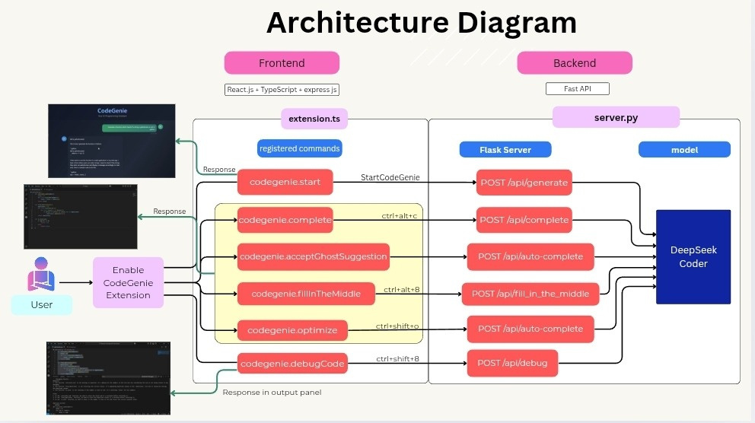

Slide 3
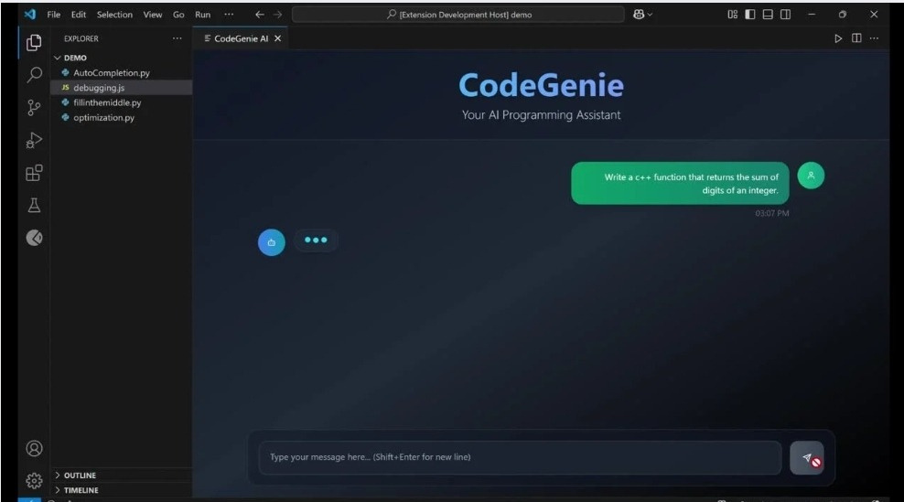
User Interface

Slide 4

Understanding VS Code extensions
react
Team collaboration
Importance of reading documentation
Learnings
How to make correct use of AI
About GPU

Slide 5
Model
Slow Performance
Faced problem in downloading the AI model
Slow performance of AI model
Challenges
Understanding vsc extension
Prompt inconsistencies
Took a bit of our time to understand how extension works, how frontend is rendered and message passing between frontend and backend
Inconsistent results

Slide 6
Thank you!

